Slide 1
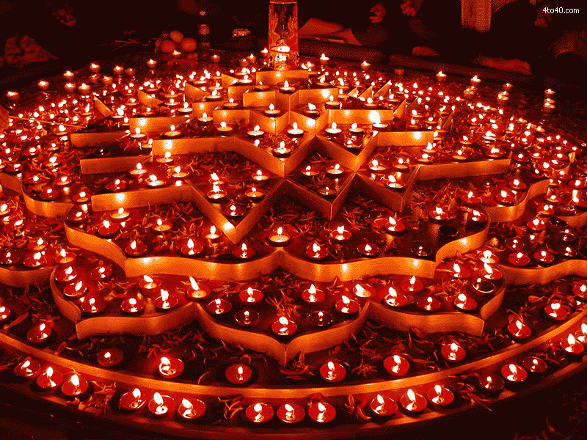
Get Diwali decorations @home
Diwali, the festival of lights and happiness. During this time of pandemic we took initiative to stand still by offering handcrafted Diwali decorations at best price in the city whereas quality is something that we ensure. For any orders you can reach @8527429924/9711851852. No delivery charges on any order above Rs.3000.

Slide 2
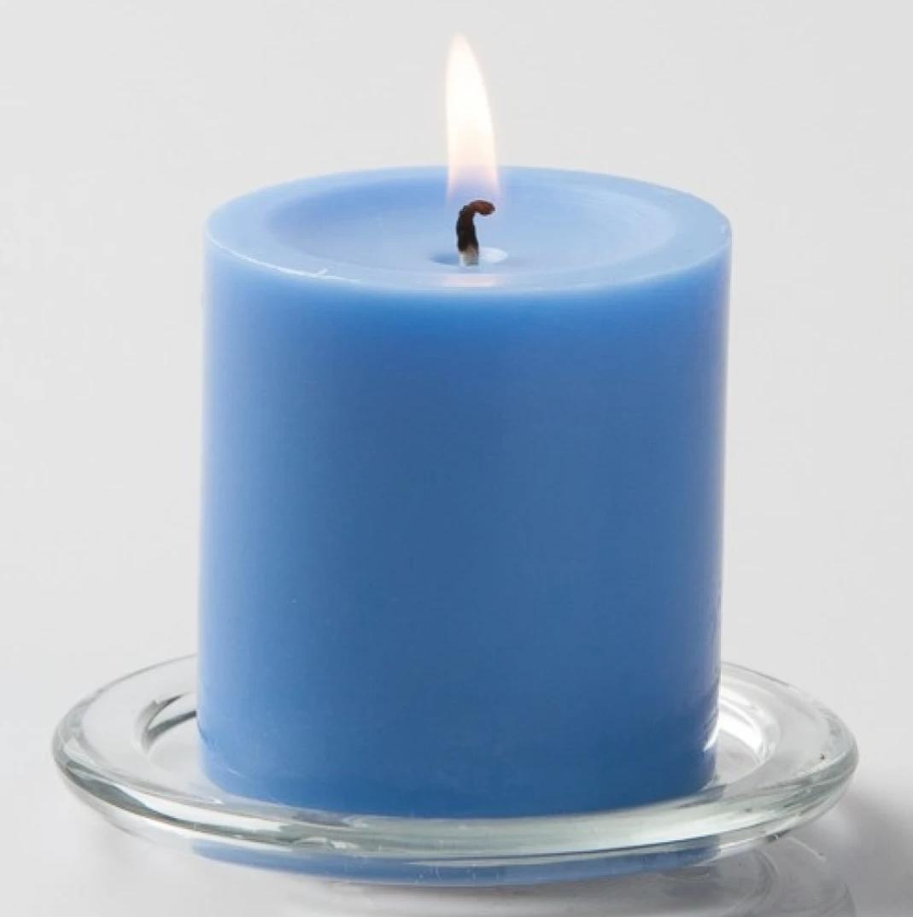
Scented Pillar Candle (colour may vary)
Code no.- 1101
Rs.110/ per piece

Slide 3

Scented Pillar Candles (set of 2) (colour may vary)
Code no.- 1102
Rs.200/ pair

Slide 4
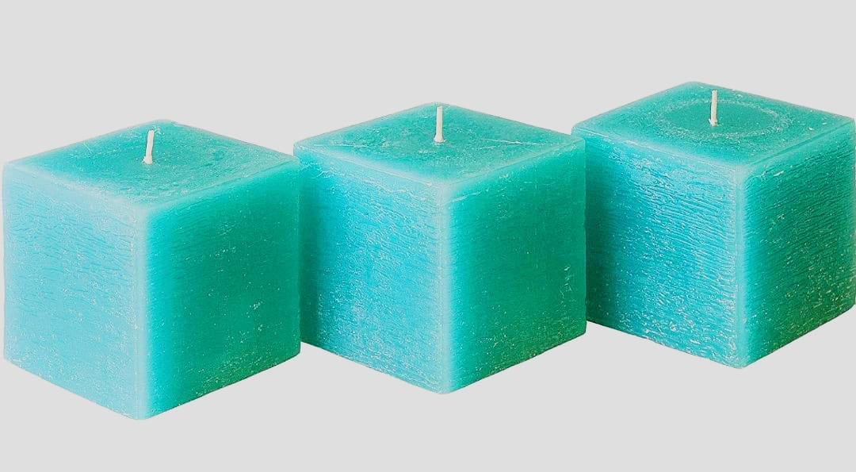
Cube Candles (set of 3) (colour can vary)
Code no. – 1104
Rs.120/ per set

Slide 5
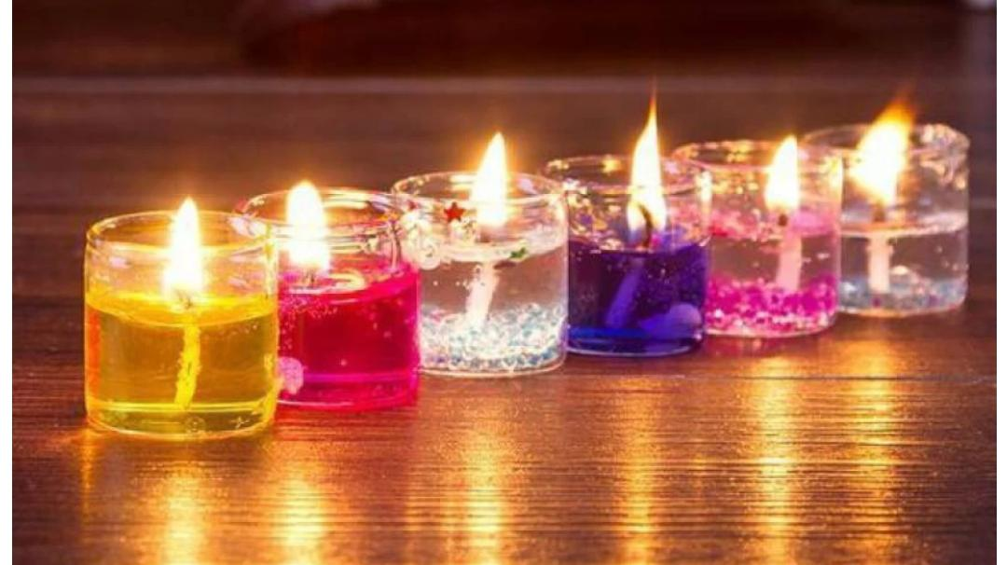
Votive Gel Candles (set of 6) minimum order of 3 sets
Code no. – 1105
Rs.200/ per set

Slide 6
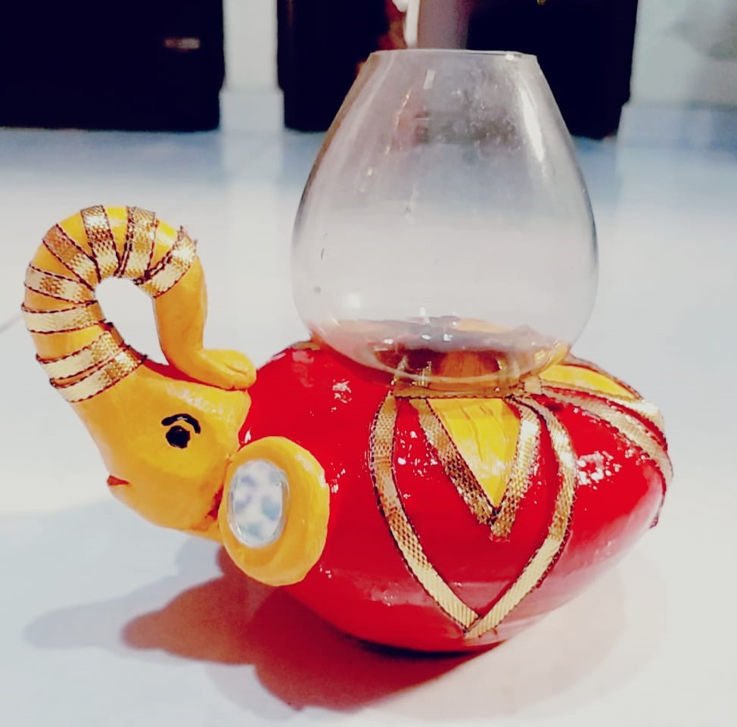
Baby elephant diya lamp (colour can vary)
Code -1107
Rs.130 per piece

Slide 7
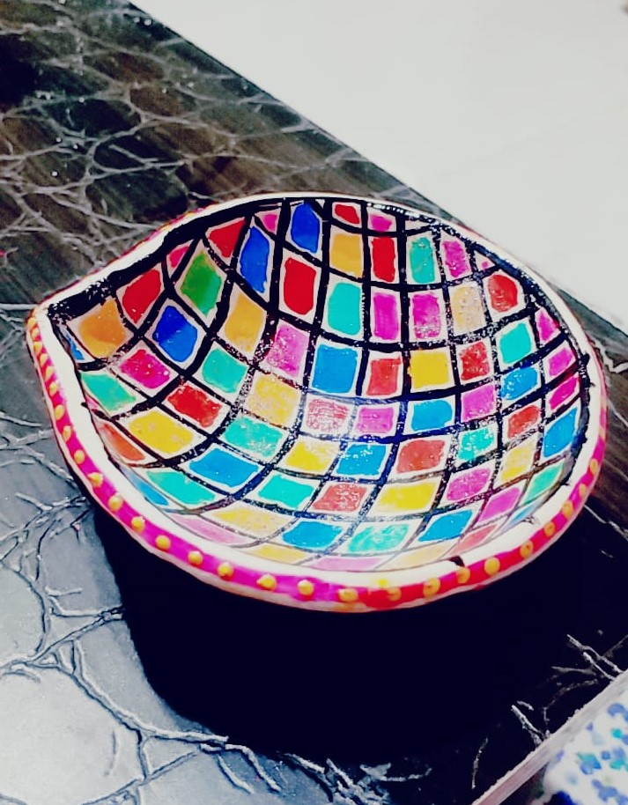
Colorful crisscross diya (Big)
Code -1107
Rs. 60 per piece

Slide 8
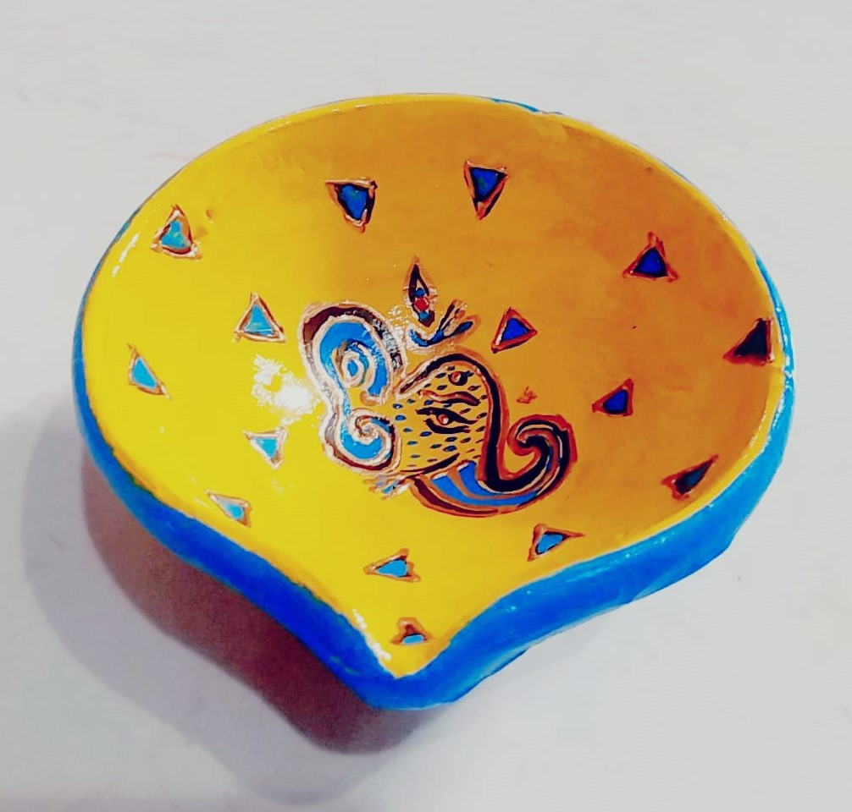
Diya designed with Ganesha (Big)
Code- 1108
Rs.60

Slide 9
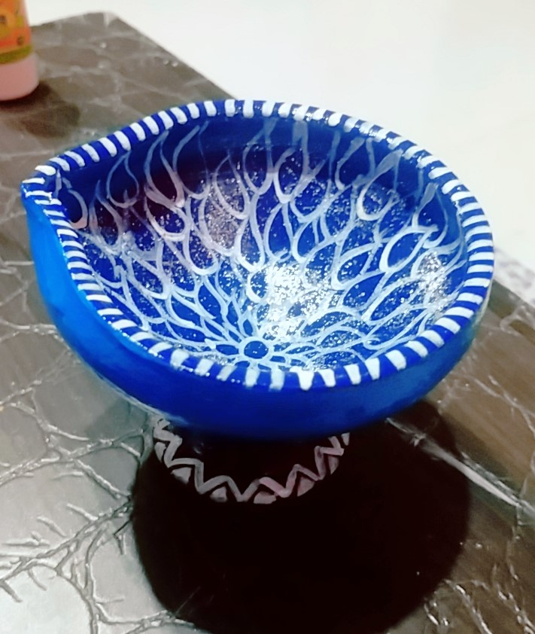
Blue silver color Diya with stand (Big)
Code- 1109
Rs.70

Slide 10
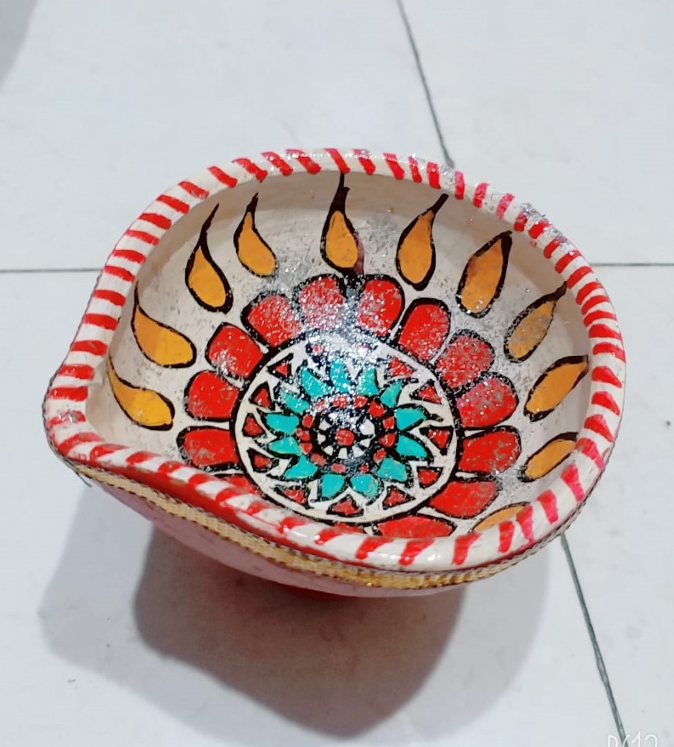
Rangoli designed Diya (Big)
Code – 1110
Rs.60 per piece

Slide 11
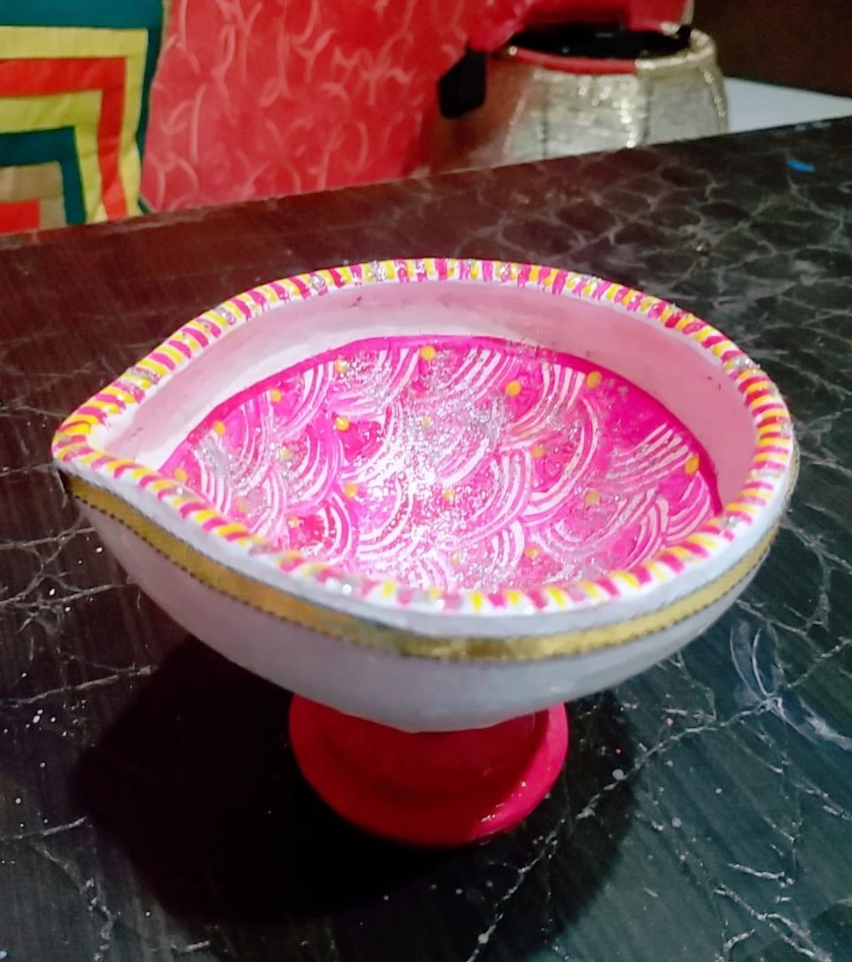
Pink silver diya with stand (Big)
Code- 1112
Rs. 70 per piece

Slide 12
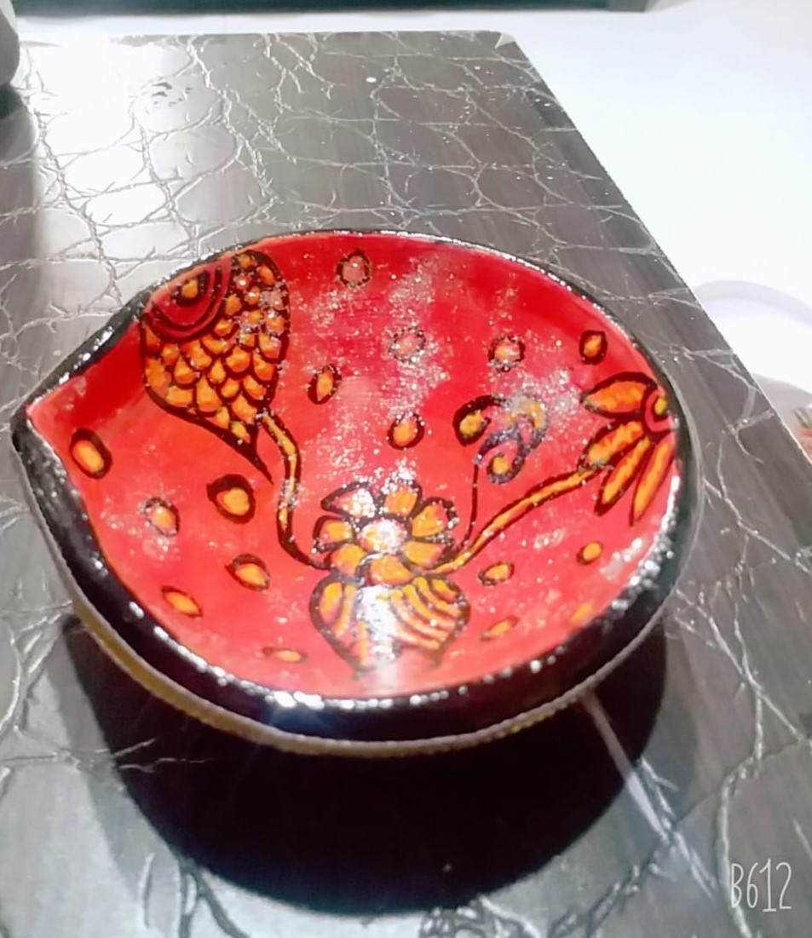
Floral designed diya (Big)
Code- 1113
Rs.50 per piece

Slide 13
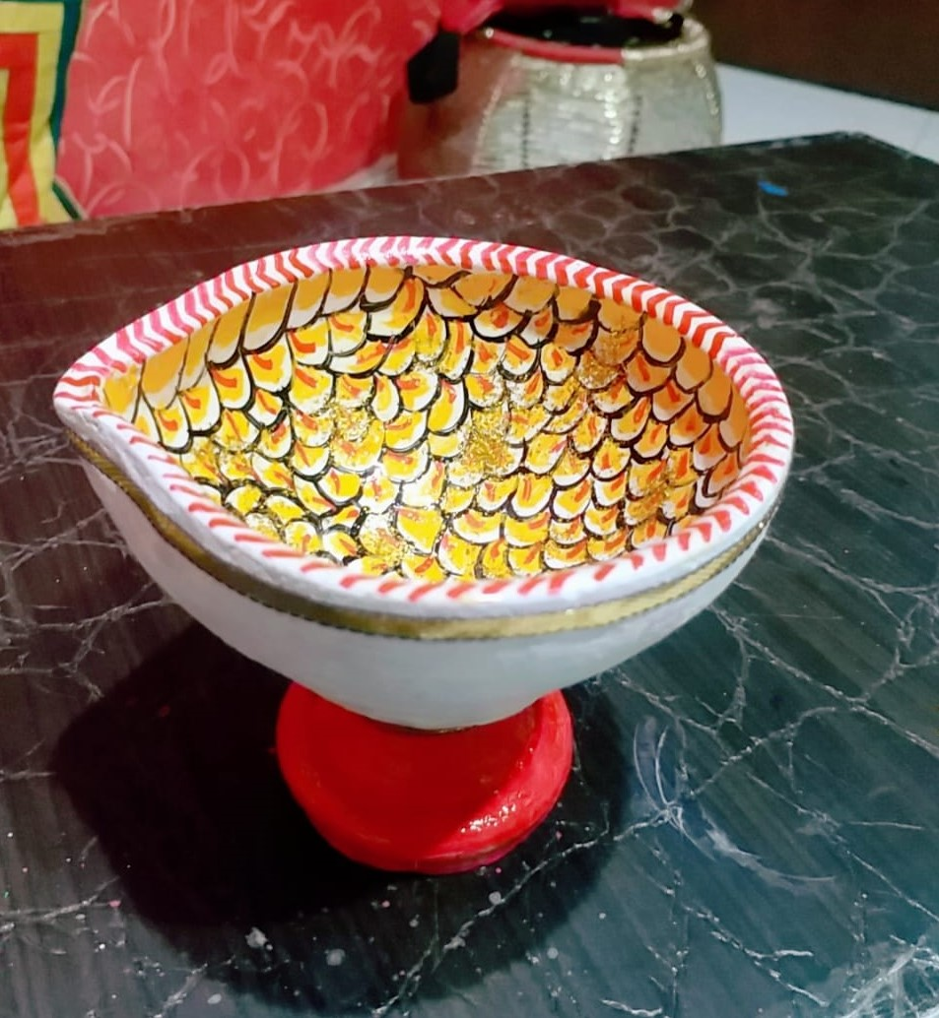
Yellow silver diya with stand (Big)
Code-1114
Rs. 70 per piece

Slide 14
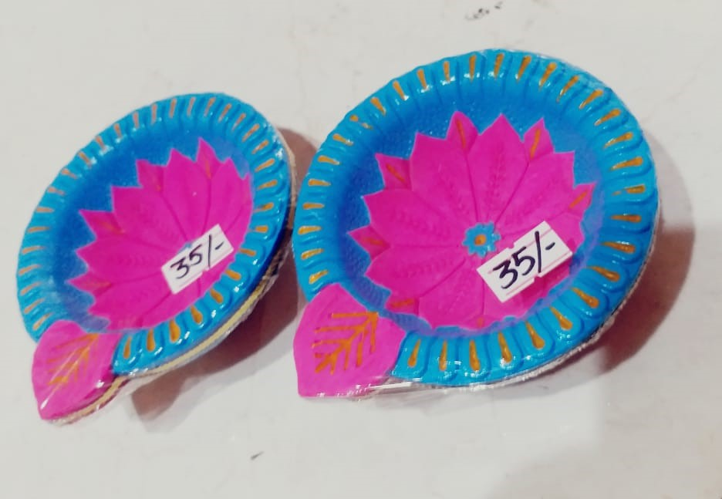
Colourful diya Set of 2
Code- 1115
Rs.70 for a pair

Slide 15
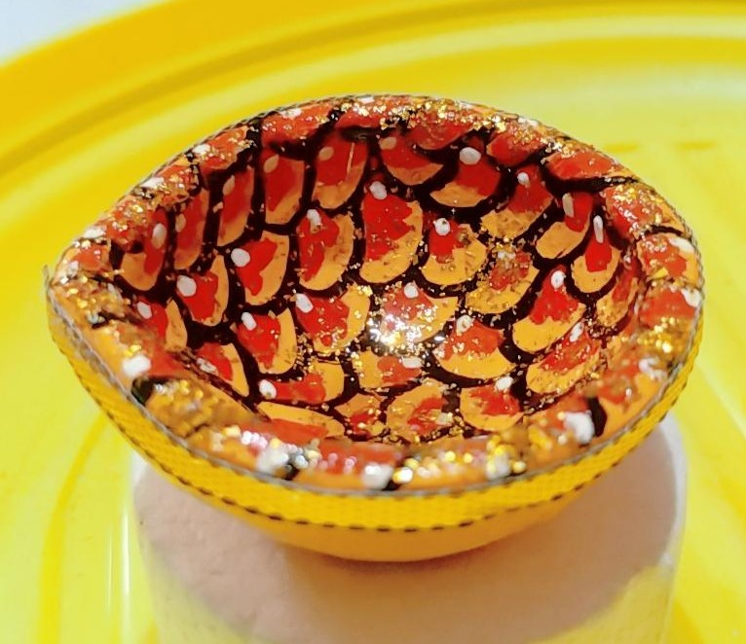
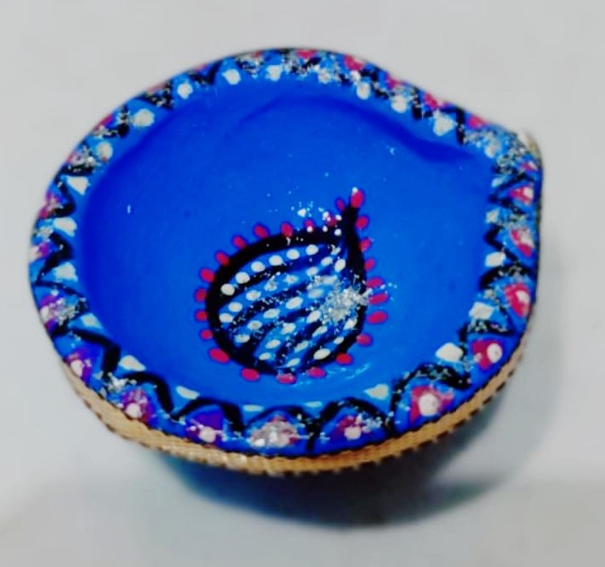
Handpainted diyas (Set of 6 small diyas) Code- 1116 Rs.120 for a set of 6pcs

Slide 16
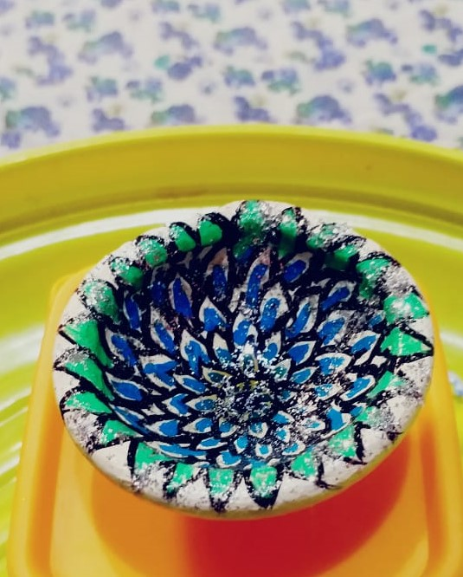
Handpainted diyas (Set of 6 small diyas) Code- 1116 Rs.120 for set of 6 pcs

Slide 17
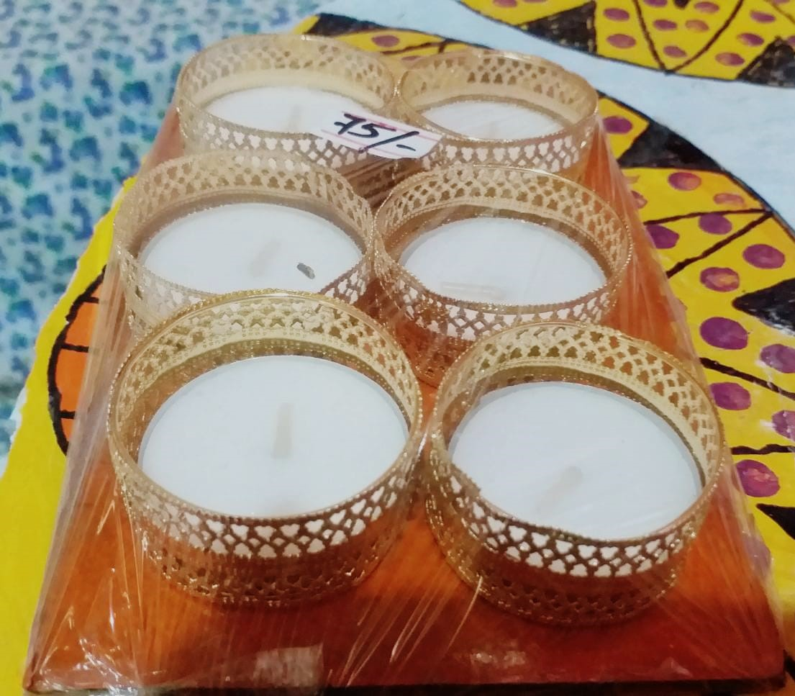
Tealight with golden holder (set of 6pcs)
Code no. 1147
Rs.75 for set of 6 diyas

Slide 18
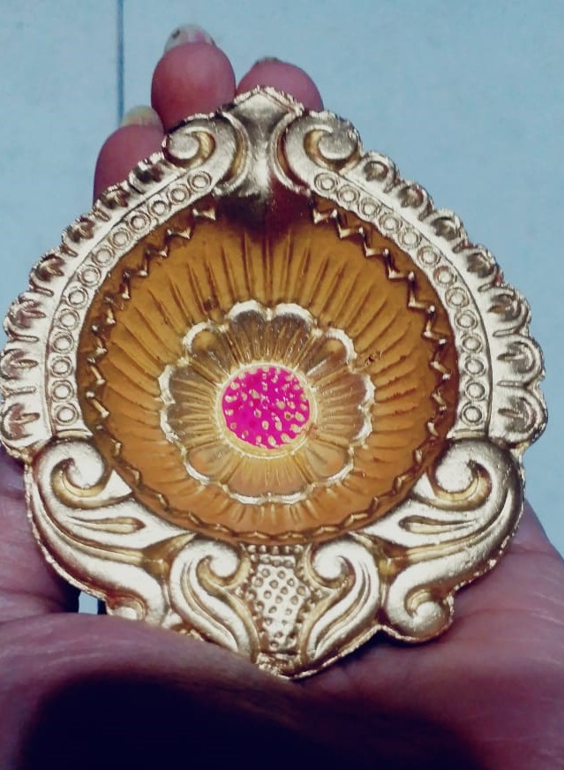
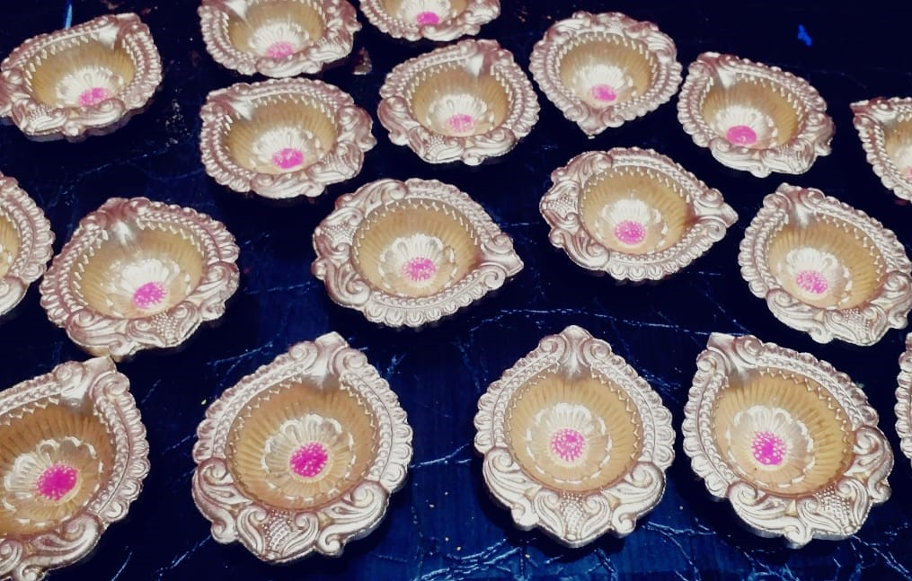
Golden diya(medium) Set of 6 piece diya Code-1149 Rs. 150 for set of 6pcs

Slide 19
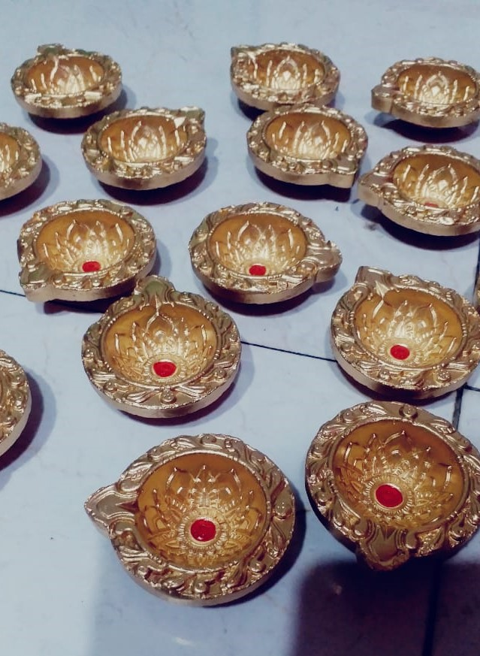
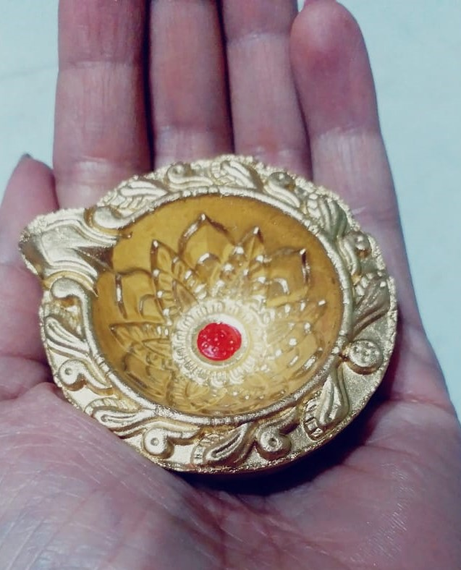
Golden diya(small) Set of 6 piece Code- 1150 Rs. 120 for set of 6pcs diyas

Slide 20
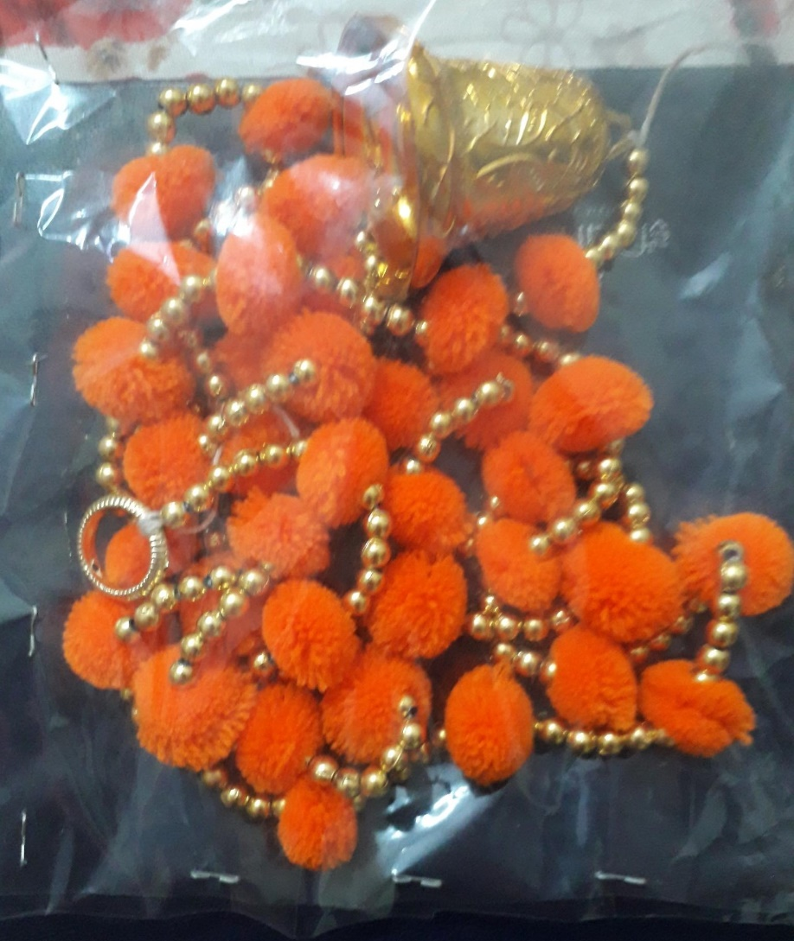
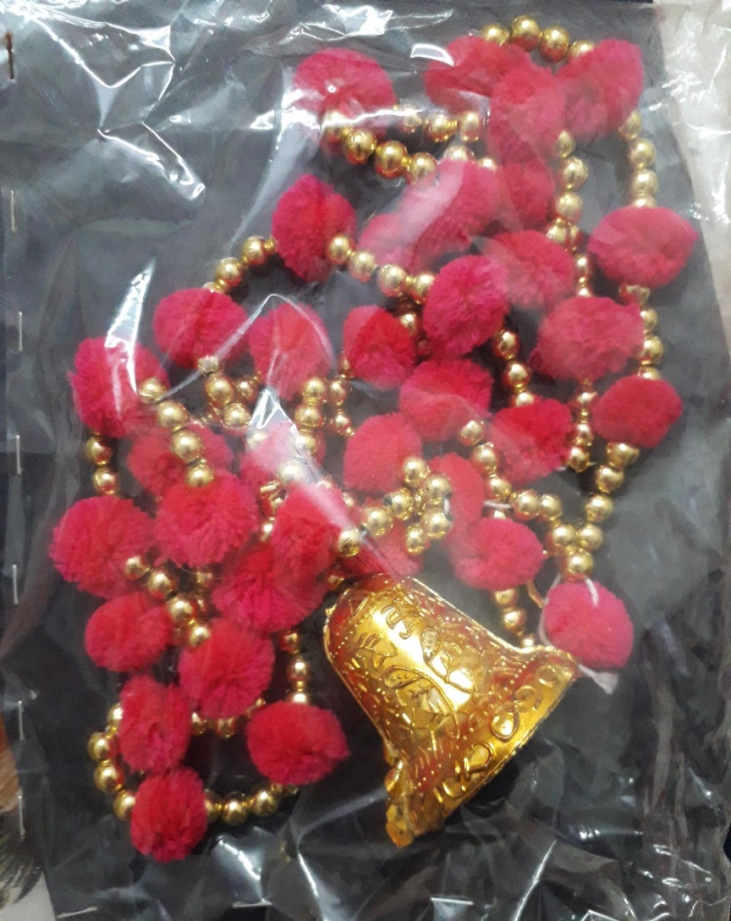
Colouful hangings Set of 2 in one colour Code- 1117 Rs.140 for a pair

Slide 21
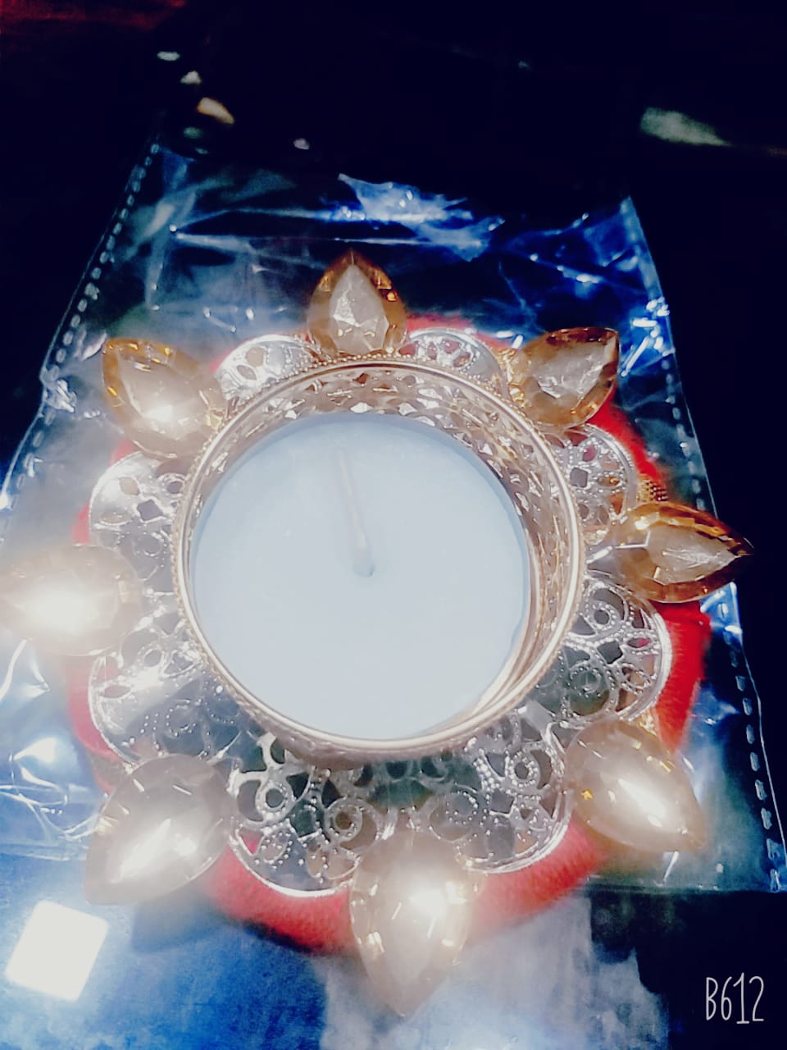
Festive Tealight Holder (colour may vary)
Code no. – 1118
Rs.120 for set of 2pcs

Slide 22
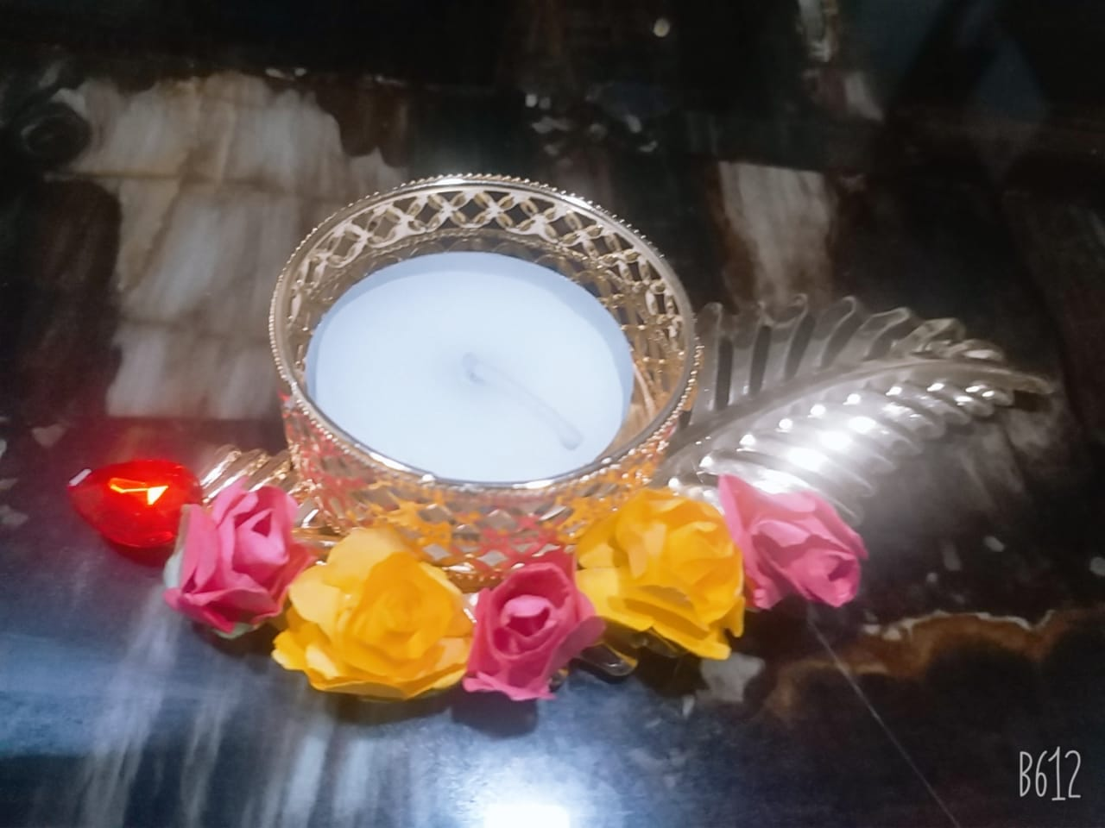
Floral Tealight Holder
Code no. – 1118
Rs.120 for set of 2 pcs

Slide 23
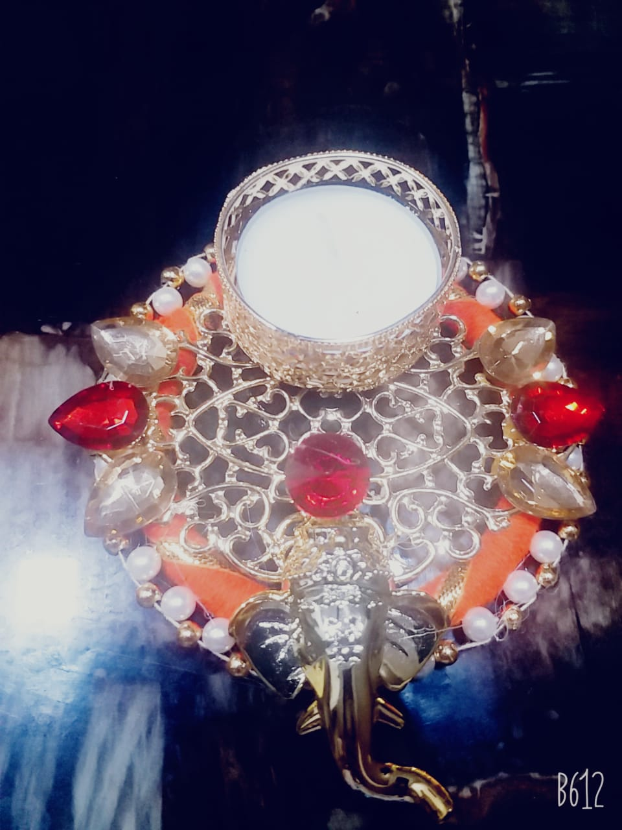
Ganesha Tealight Holder (set of 2)
Code no. – 1119
Rs. 150 for set of 2 pcs

Slide 24
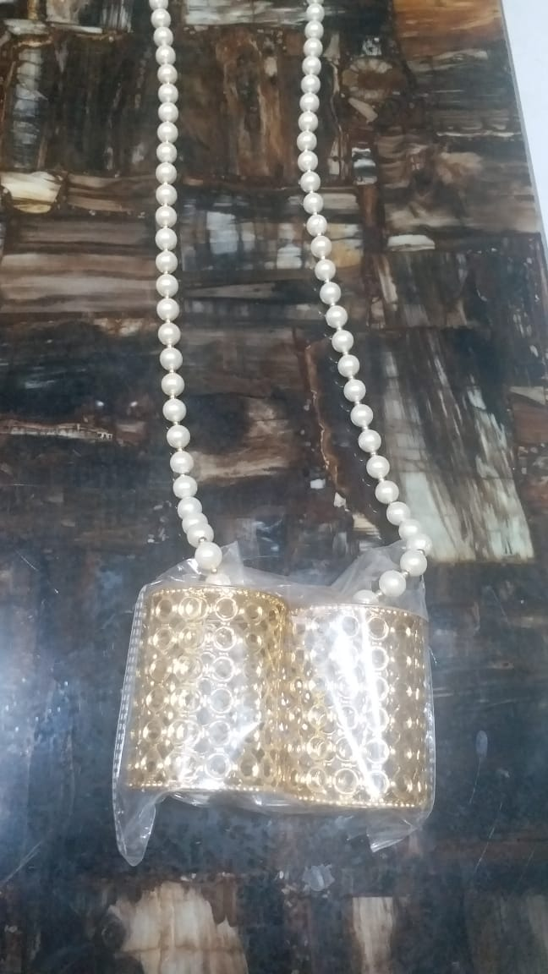
Festive Pearl Hangings (set of 2)
Code no. – 1120
Rs.200 for one pair

Slide 25
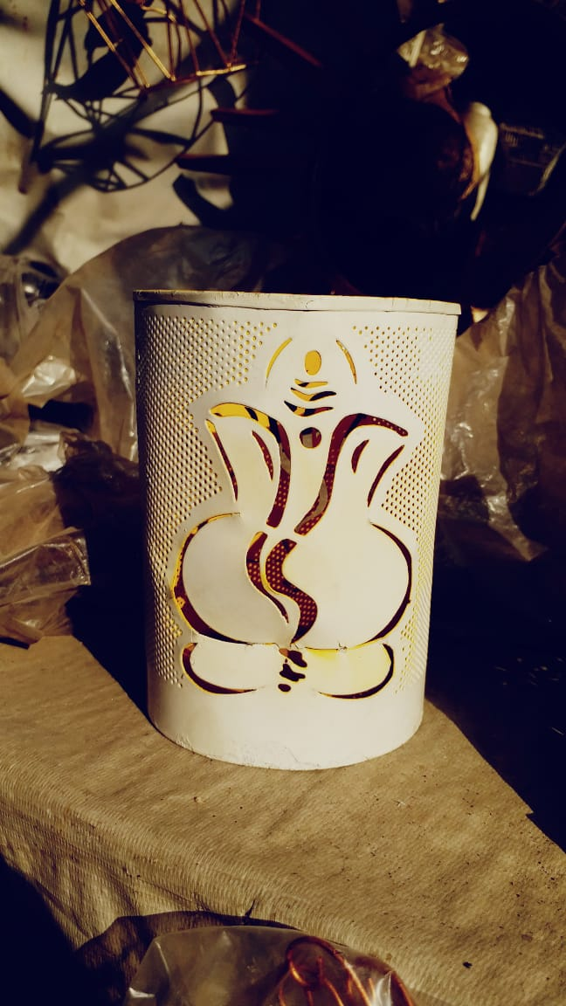
Ganesha Tealight Holder
Code no. – 1121
Rs.300 per piece

Slide 26
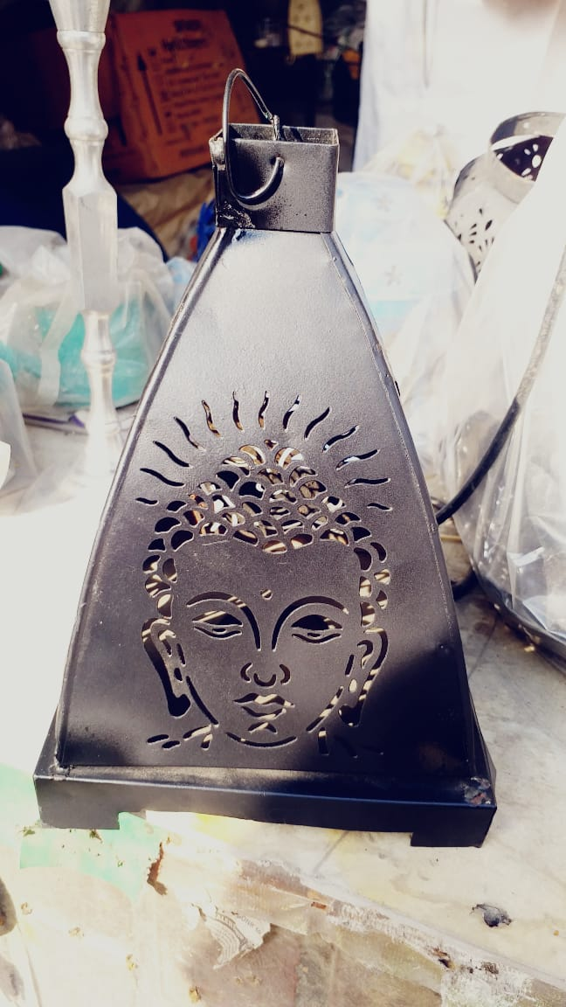
Buddha Lantern
Code no. – 1122
Rs.300 per piece

Slide 27
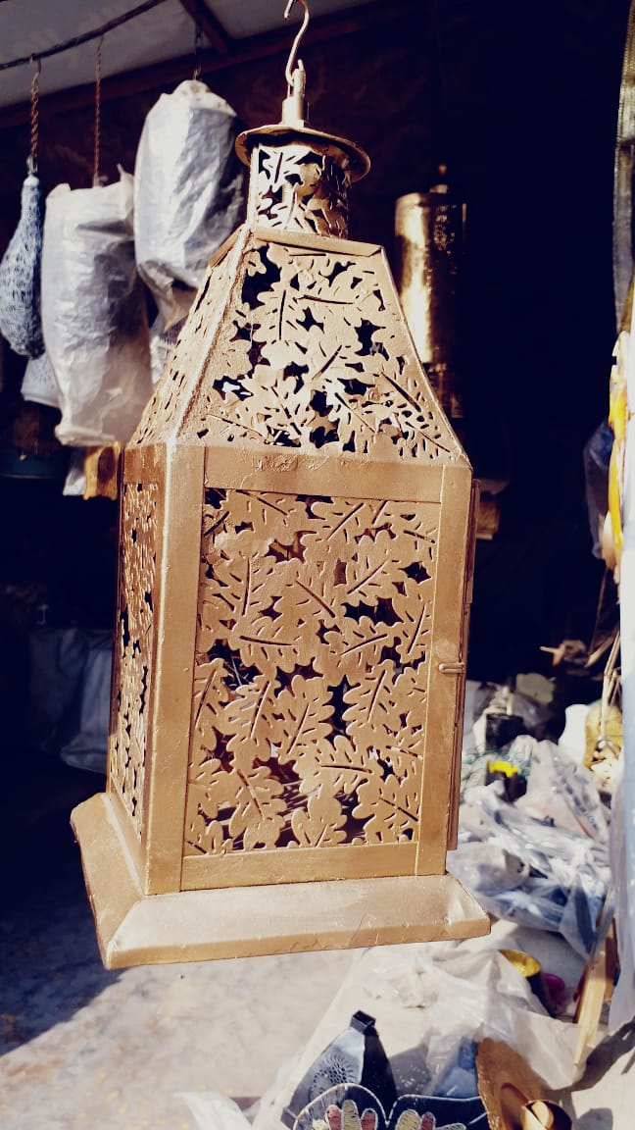
Leaf Cut Lantern
Code no. – 1123
Rs. 300 per piece

Slide 28
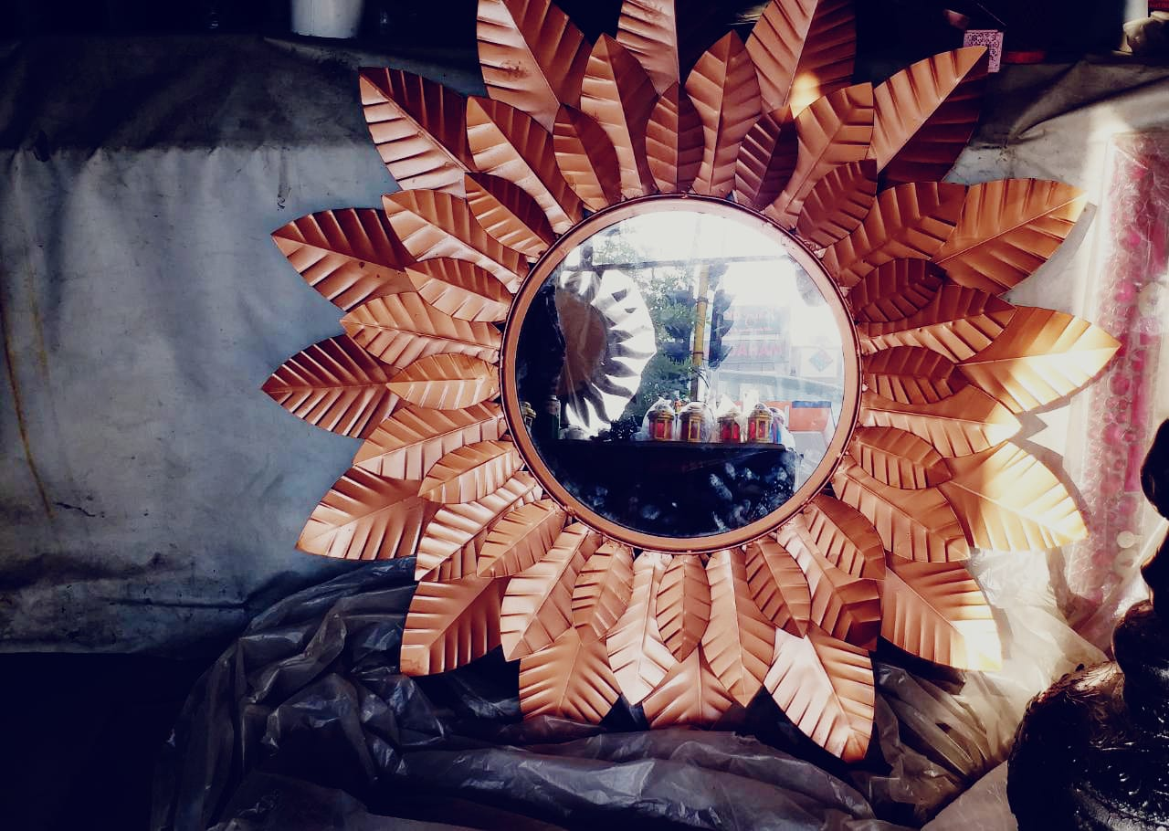
Sunflower Mirror
Code no. – 1124
Rs. 800 per piece

Slide 29
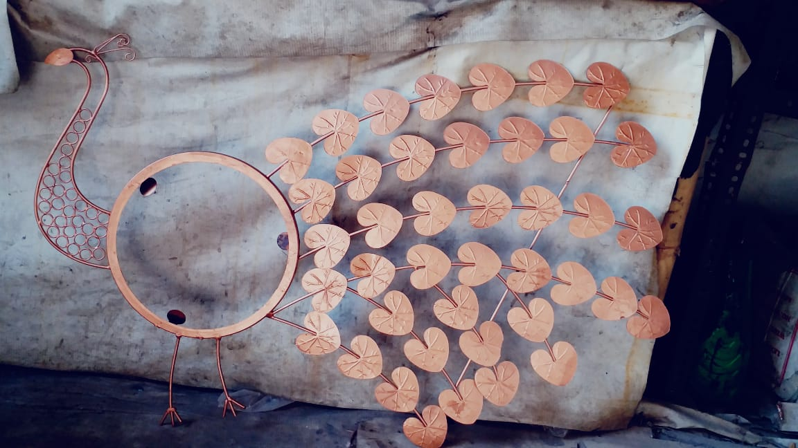
Peacock Wall Hanging
Code no. – 1126
Rs.750 per piece

Slide 30
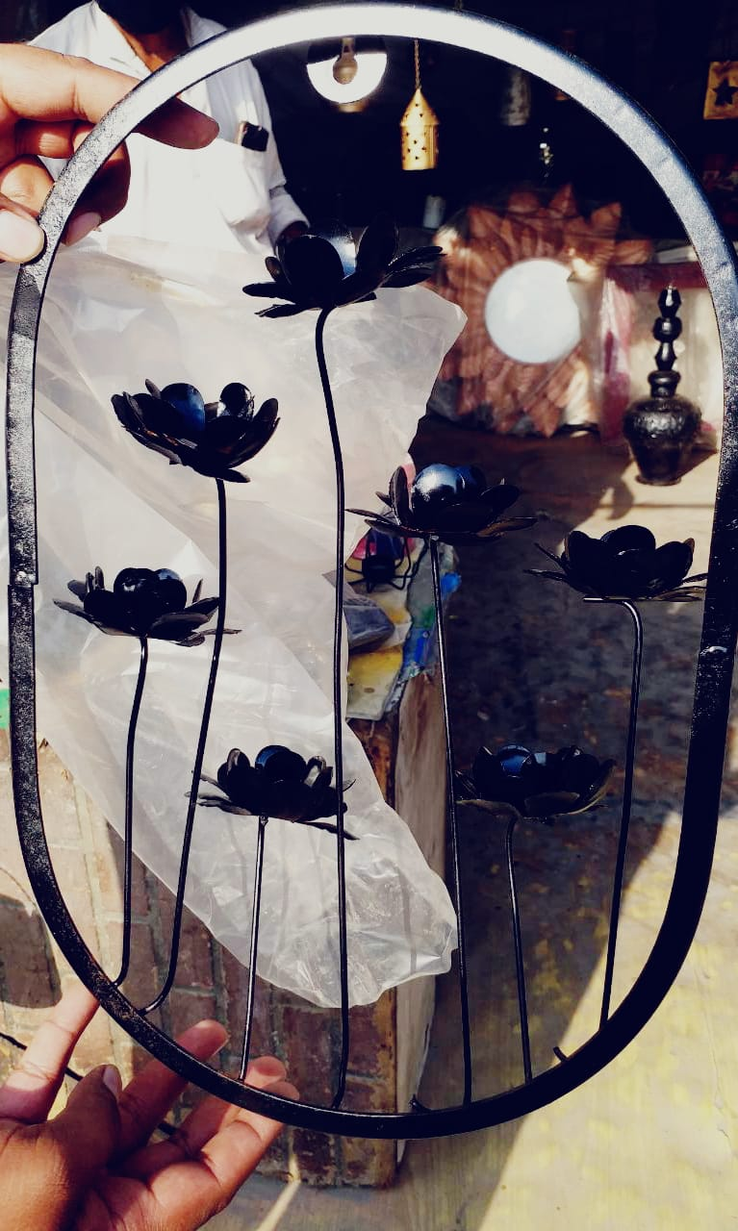
Floral Wall Hanging with Tealight Holder
Code no. - 1128
Rs. 350 per piece

Slide 31
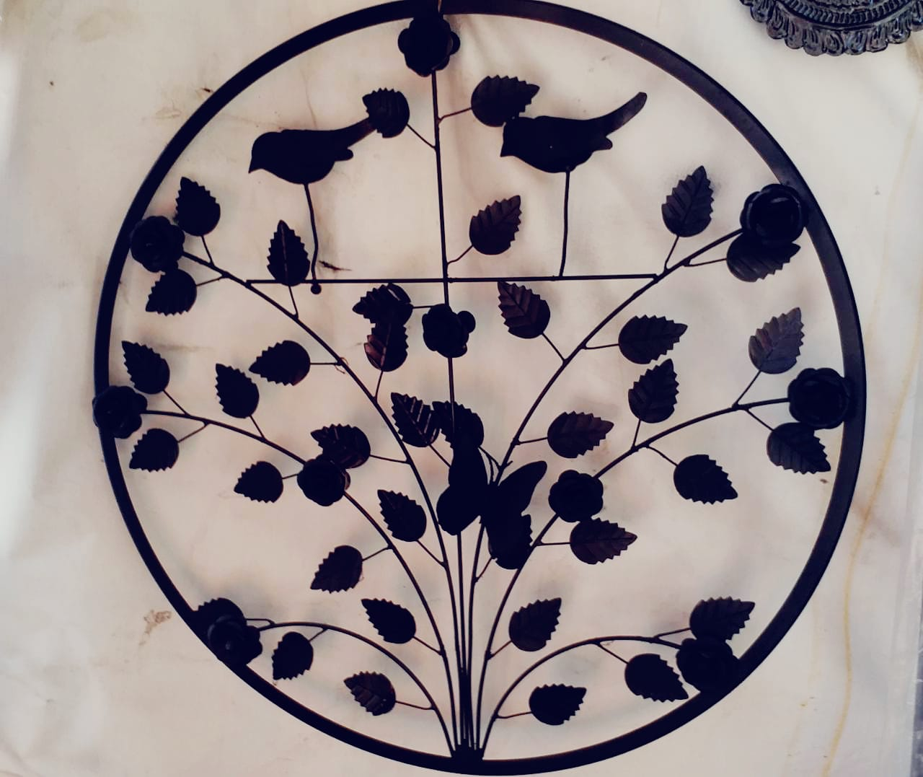
Leafy Wall Hanging
Code no. – 1129
Rs. 400 per piece

Slide 32
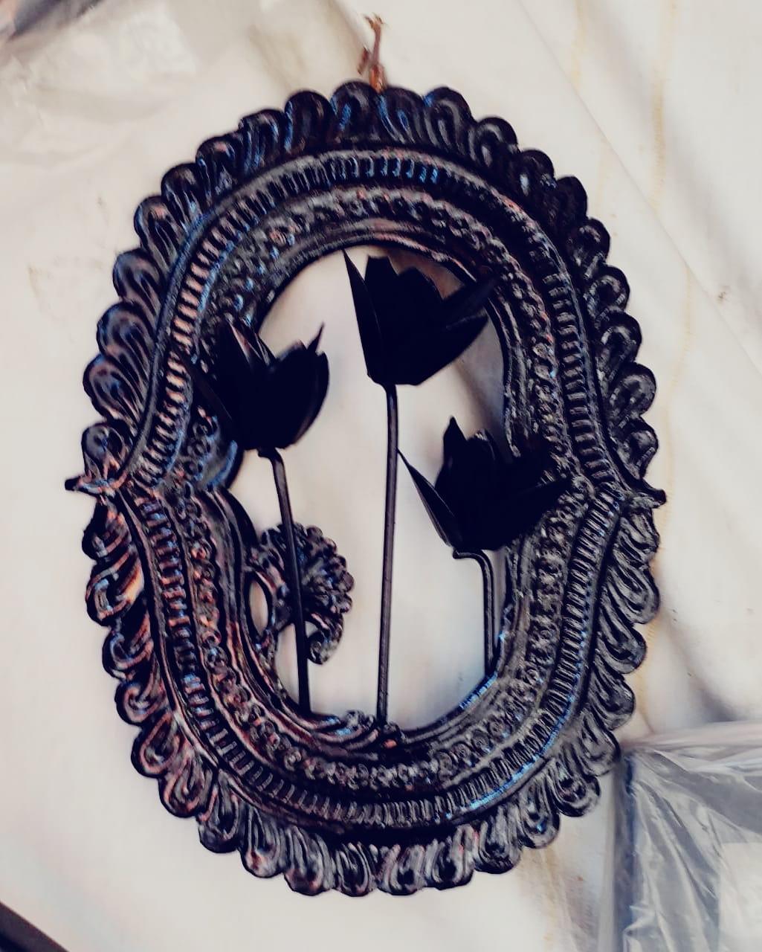
Floral Wall Hanging (oval shape)
Code no. – 1130
Rs. 350 per piece

Slide 33
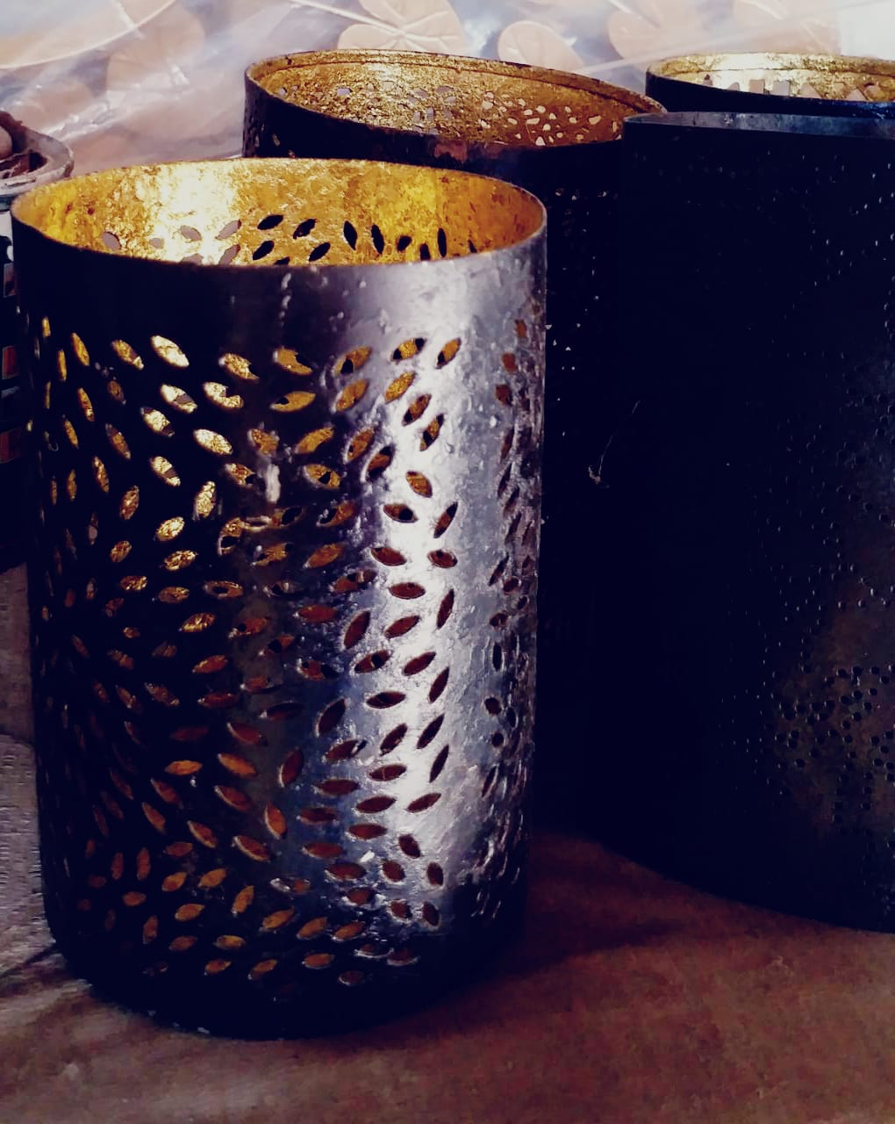
Leaf cutout Metal Tealight holders
Code no. – 1131
Rs. 250 per piece

Slide 34
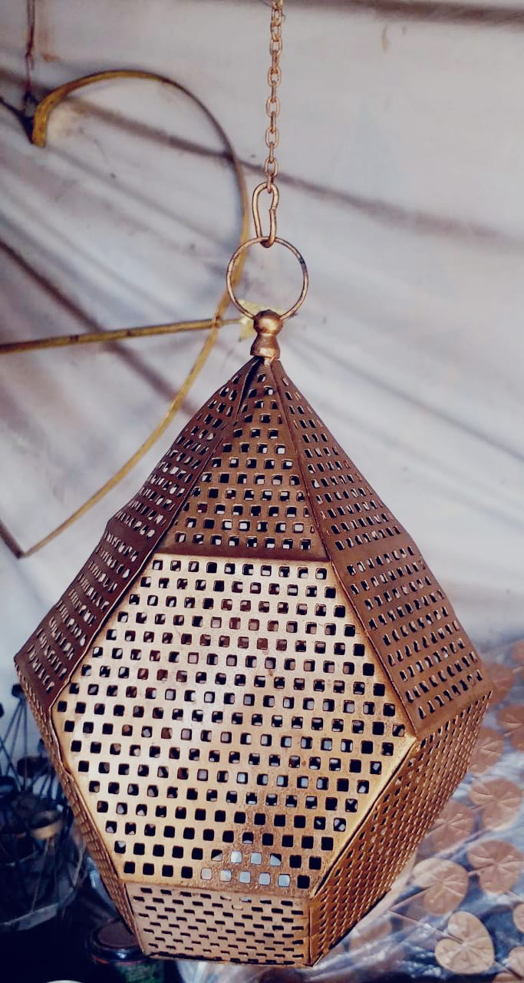
Hexagonal Metal Tealight Wall Hanging
Code no. - 1133
Rs. 400 per piece

Slide 35
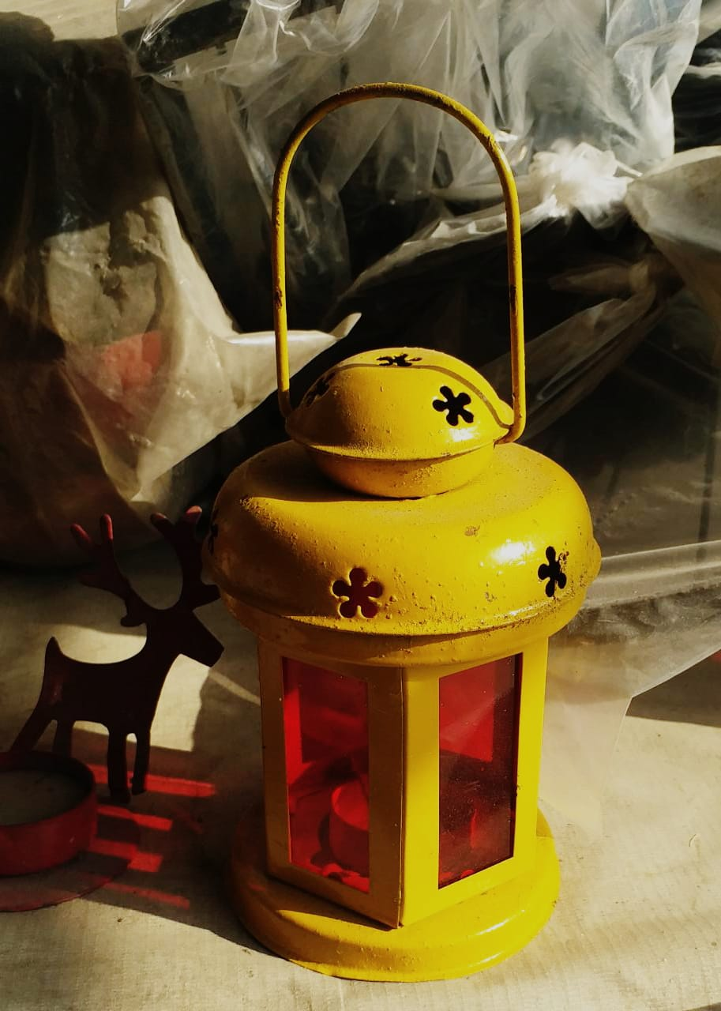
Antique Lantern (colour may vary)
Code no. – 1136
Rs. 350 per piece

